Slide 1
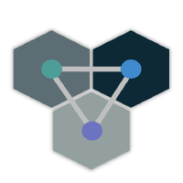


Process Orchestration with ColonyOS Johan Kristiansson, PhD
CTO, RockSigma AB
Senior Researcher, RISE AB

Slide 2
Introduction
RockSigma – Computational Engine for Seismic Processing
How to process 10⁶ seismograms every day?
How to spin up a huge amount of Docker containers in a short time?
RISE - Space Data Lab (Digital Earth Sweden)
How to download and analyze petabyte of satellite data?
And how to handle system failures and make sure all data are eventually processed?
RISE - Edge computing
How to easily deploy and configure edge applications?

Slide 3
We need to orchestrate “processes” across platforms
IoT devices, web servers, Kubernetes clusters, public cloids, edge servers, smart phones,
and neuromorphic devices …
How to design multi-platform applications?
How to manage security across platforms?
How to automate repeating tasks across platforms?
How to operate multi-platform applications?
How to discovery services?
Notes:
In all these projects. We eventually ended up in an hybrid environment, especially in the edge project.
One problem today is that Silos!

Slide 4
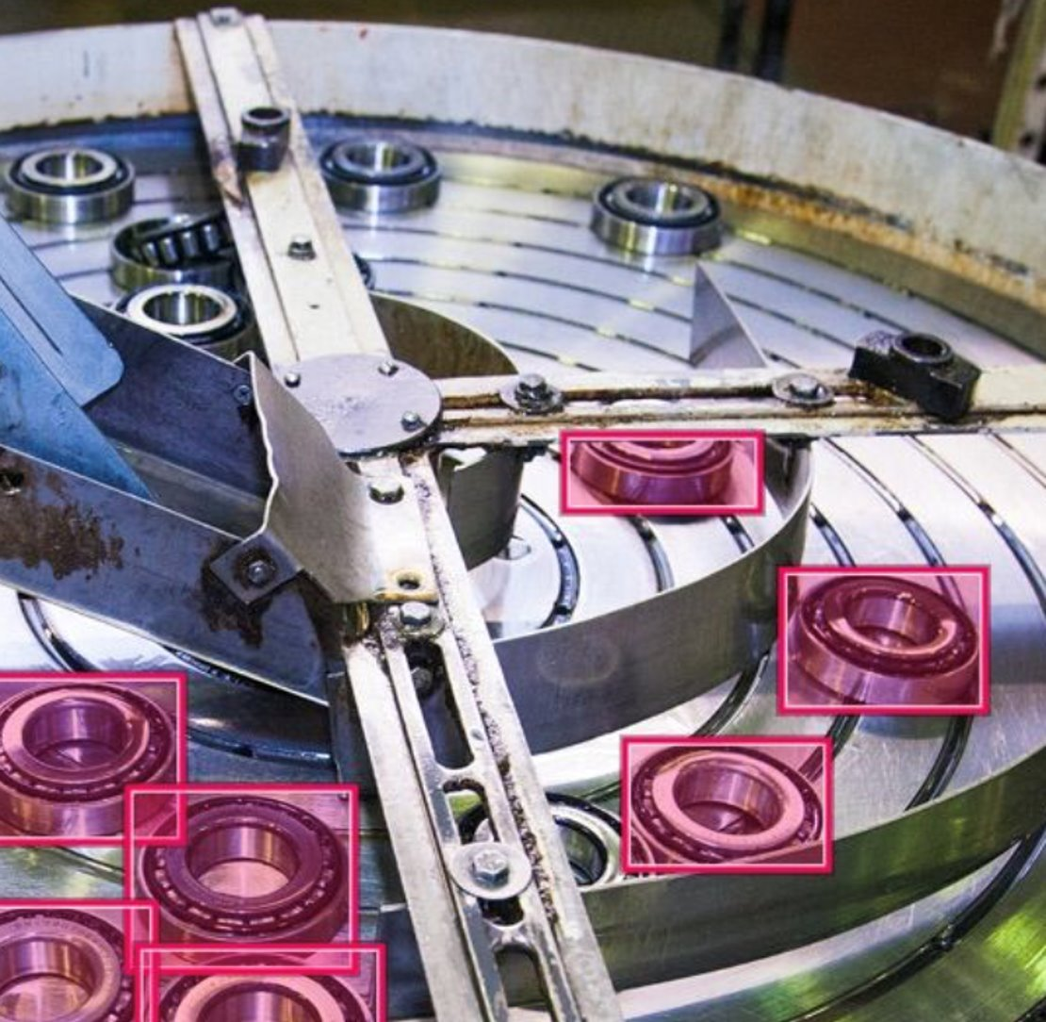
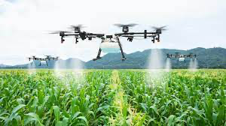
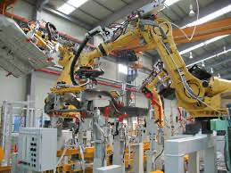
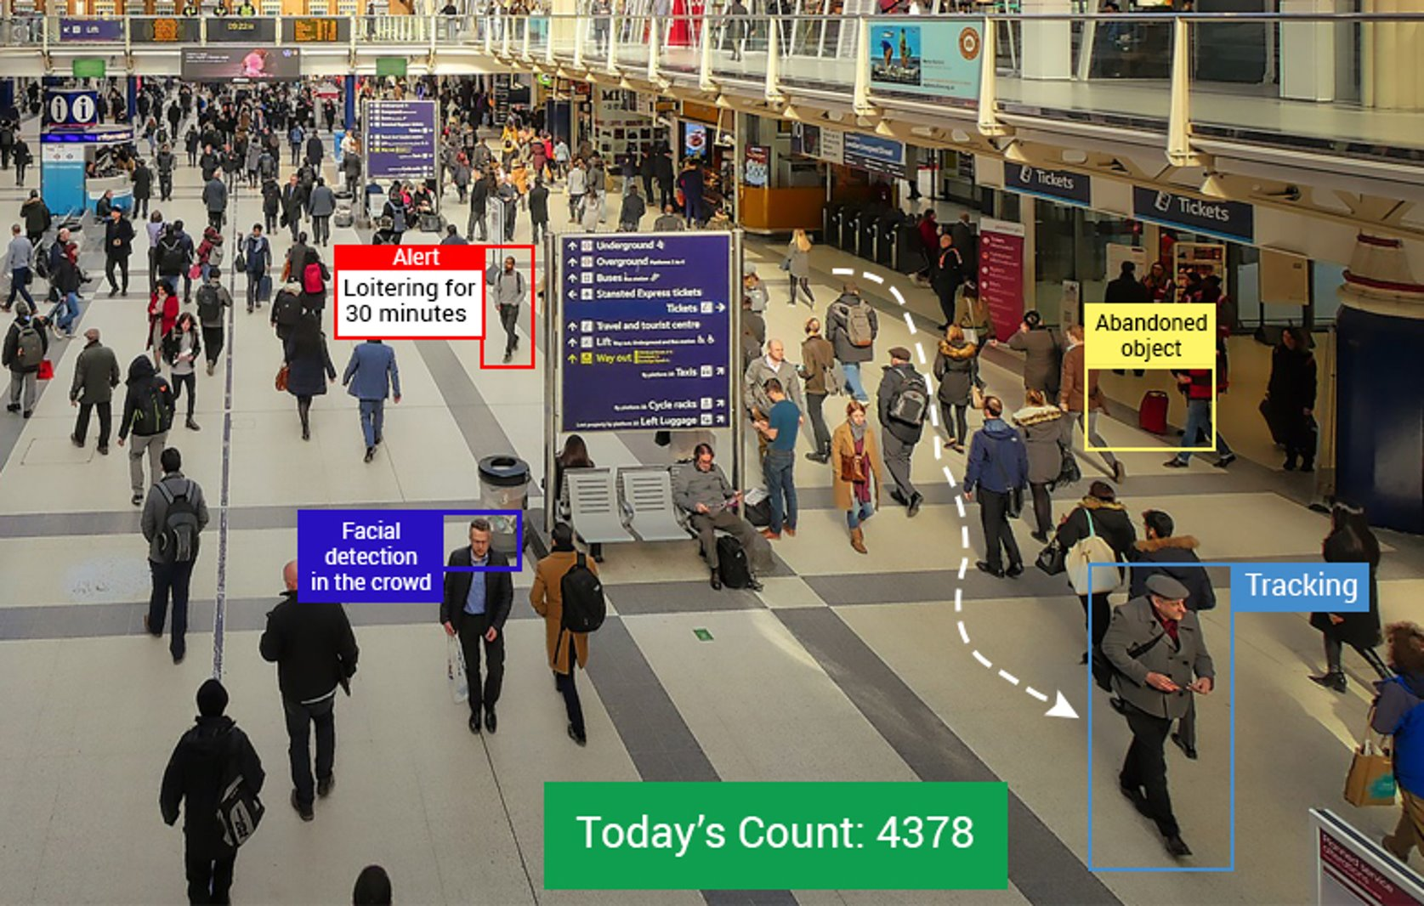
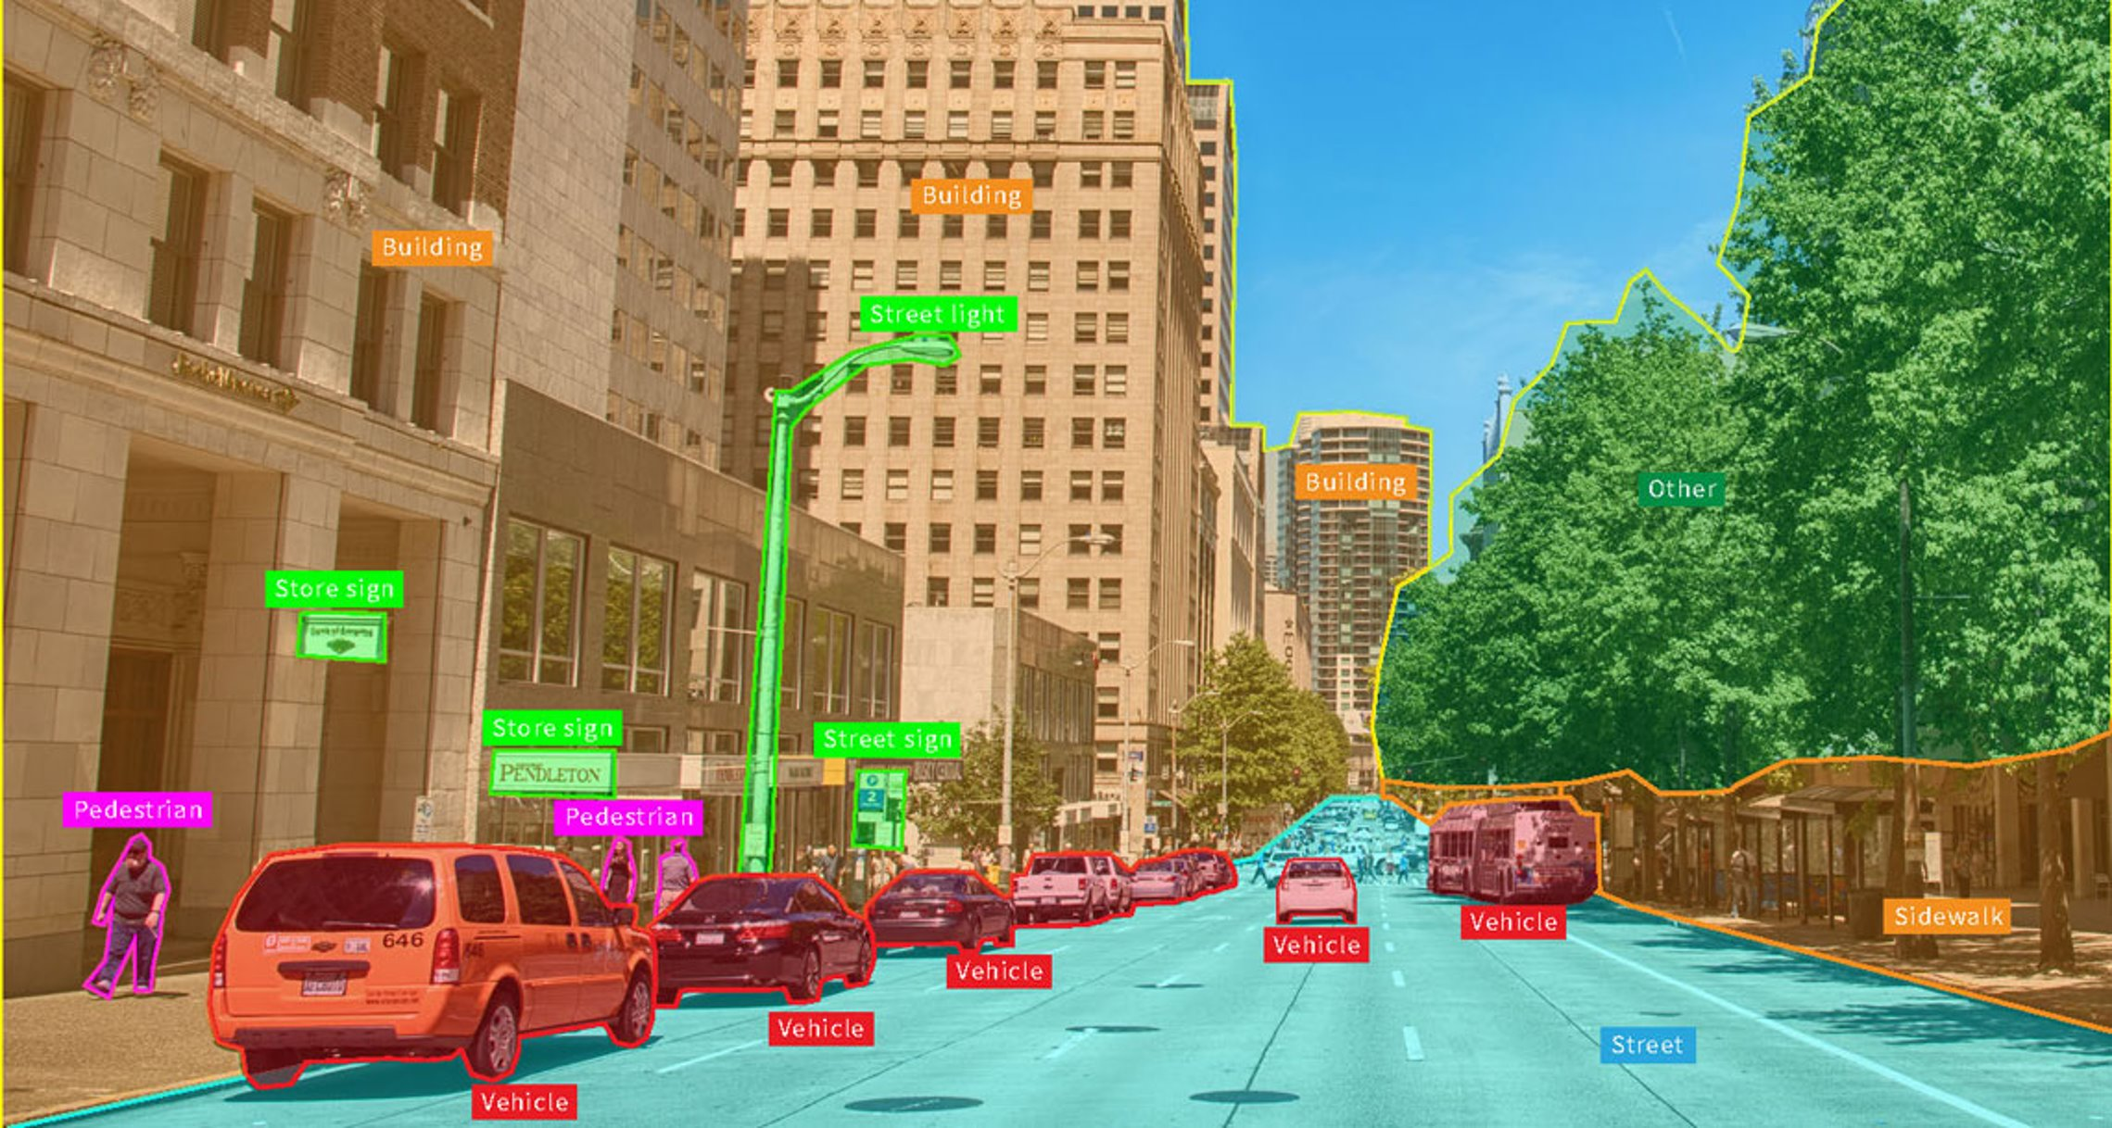
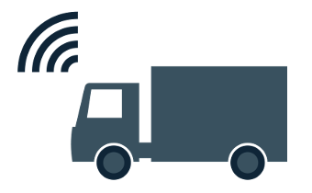
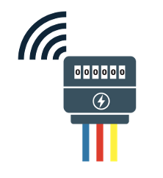
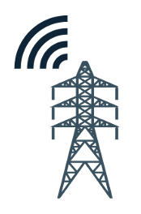


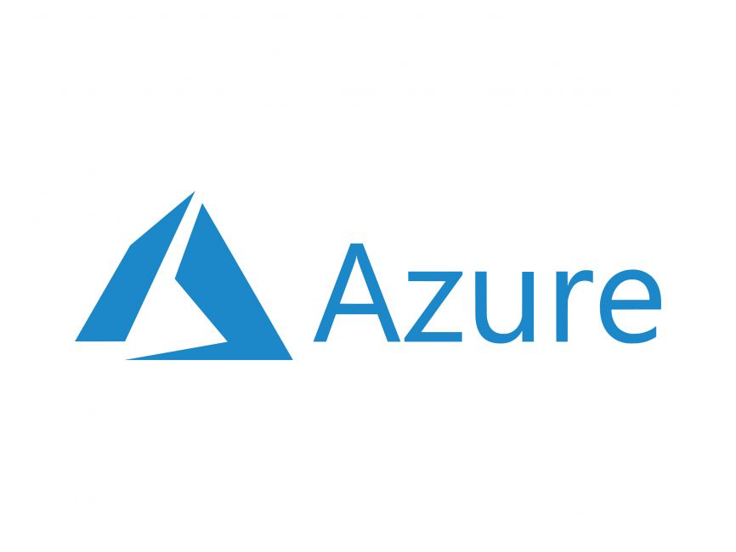
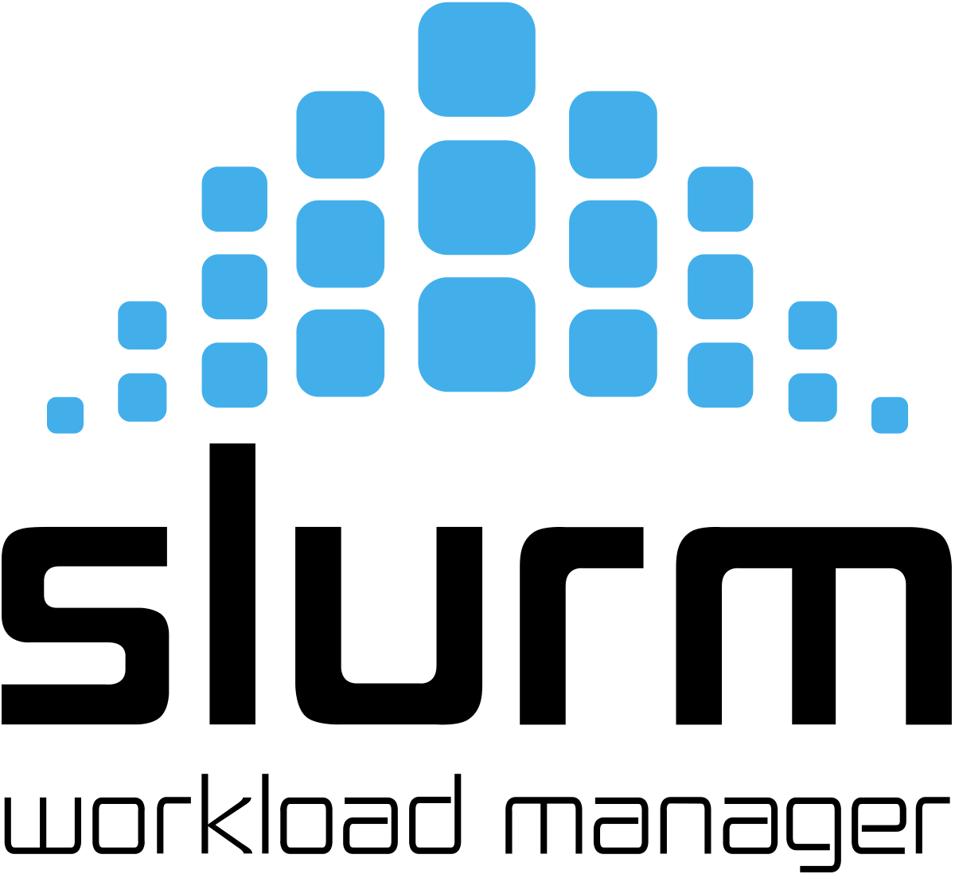
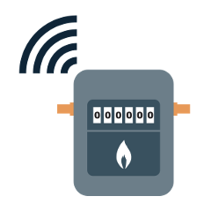


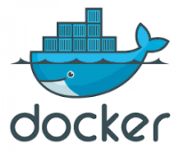

The need for a “Meta” Operating System?
Meta OS
Device
Edge
Cloud
HPC
Notes:
We need to orchestrate “processes” across platforms
IoT devices, web servers, Kubernetes clusters, edge servers, smart phones etc.
Challenges
Workflow management?
Software architectures?
Microservices? Serverless computing? Integration?
Security?
Robustness?
Failure management?
Deployment and operation?
Configuration management?

Slide 5
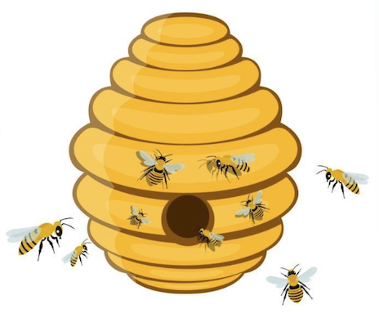
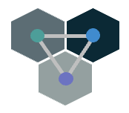
ColonyOS
A Colony is like a Bee Colony, but for computer software
A Colony is a trusted community of remotely connected computer programs (so-called workers) organized as a single unit to perform execution of various tasks
Zero-trust infrastructure for worker communication and task execution coordination within a Colony
It is a platform for Process orchestration
Framework for implementing next-generation distributed applications and systems
Open source project
https://github.com/colonyos/colonies

Slide 6

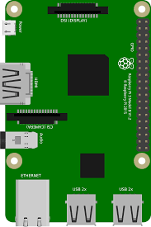
A process is the instance of a computer program that is being executed by one or many threads.
A process may be “side effects”, i.e. interact with our real world.
Example of processes:
Turn on a lamp
Train a neural network
Copy data to Amazon S3
Start a webcam
Dispatch a drone
Ask user for permission
Analyze satellite image
Modifies
Computer
Environment

Slide 7
OS
P2
f₂
OS processes/routines
P1
f₁

Slide 8
A meta-process describes a software process that is going to be executed in the future and contains “meta” information about the actual process.
Meta-processes
P1
f₁
P2
f₂
Every “meta-process” specifies exactly one function
The real “process” can either run as a OS process or as a routine in an application or server
OS
P2
f₂
OS processes/routines
P1
f₁

Slide 9
Process ID | Assigned Worker ID | Worker type | Function | Args | State
P1 | W1 | Camera device | f₁ |  | Running
P2 | W1 | Camera device | f₂ |  | Running
P3 | None | Cloud worker | f₃ |  | Waiting
P3
f₃
Meta-processes
P1
f₁
P2
f₂
DB
Colonies Server(s)
API
OS
Colonies Worker W1
P2
f₂
OS processes/routines
P1
f₁

Slide 10
P3
f₃
Meta-processes
P1
f₁
P2
f₂
DB
Colonies Server(s)
API
Assign
OS
Colonies Worker W1
Colonies Worker W2
P2
f₂
OS processes/routines
P1
f₁

Slide 11
P3
f₃
Meta-processes
P1
f₁
P2
f₂
DB
Colonies Server(s)
API
Meta
process
OS
Colonies Worker W1
Colonies Worker W2
P2
f₂
OS processes/routines
P1
f₁

Slide 12
P3
f₃
Meta-processes
P1
f₁
P2
f₂
DB
Colonies Server(s)
API
OS
Colonies Worker W1
Colonies Worker W2
Launch
P2
f₂
OS processes/routines
P1
f₁
P3
f₃

Slide 13
P3
f₃
Meta-processes
P1
f₁
P2
f₂
DB
Colonies Server(s)
API
Close process
OS
Colonies Worker W1
Colonies Worker W2
P2
f₂
OS processes/routines
P1
f₁

Slide 14
A Colonies Workflow is a dependency graph of composable functions that can be implemented seperately and independently without understanding the whole system
P1
f₁
P2
f₂
P3
f₃
P4
f₅
P5
f₆
P6
f₄
P7
f₄
P8
f₄
P9
f₇
Enables complex machine learning workloads in compute continuums spanning devices, clouds and edge networks over the Internet

Slide 15
P1
f₁
P2
f₂
P3
f₃
P4
f₅
P5
f₆
P6
f₄
P7
f₄
P8
f₄
P9
f₇
Colonies Runtime API
Colonies Worker
Colonies Worker
Colonies Worker
Colonies Worker
Colonies Worker
Colonies Worker
P6
f₄
P7
f₄
P8
f₄
P9
f₇
P5
f₆
P4
f₅
P3
f₃
P1
f₁
P2
f₂
Kubernete Pod
Kubernete Pod
Edge
IoT Device
IoT Devies
Smart phones

Slide 16
P1
f₁
Function-as-a-service
https://en.wikipedia.org/wiki/Function_as_a_service
BUT, with with universal access across platforms
(not only within one cloud)
P2
f₂
P3
f₃
P4
f₅
P5
f₆
P6
f₄
P7
f₄
P8
f₄
P9
f₇
Colonies Runtime API
Colonies Worker
Colonies Worker
Colonies Worker
Colonies Worker
Colonies Worker
Colonies Worker
P6
f₄
P7
f₄
P8
f₄
P9
f₇
P5
f₆
P4
f₅
P3
f₃
P1
f₁
P2
f₂
Kubernete Pod
Kubernete Pod
Edge
IoT Device
Web Browser
Smart phones

Slide 17
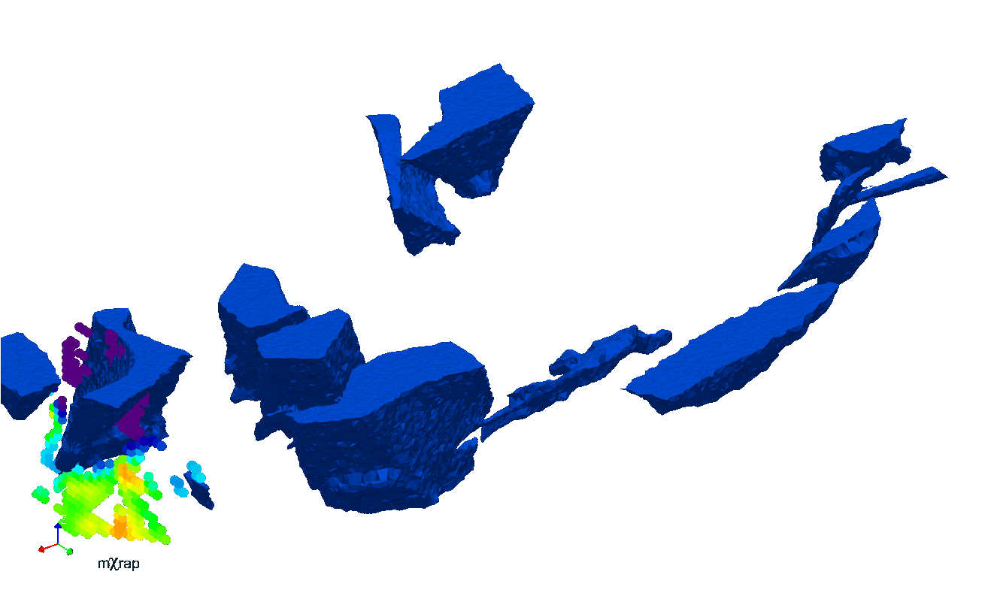
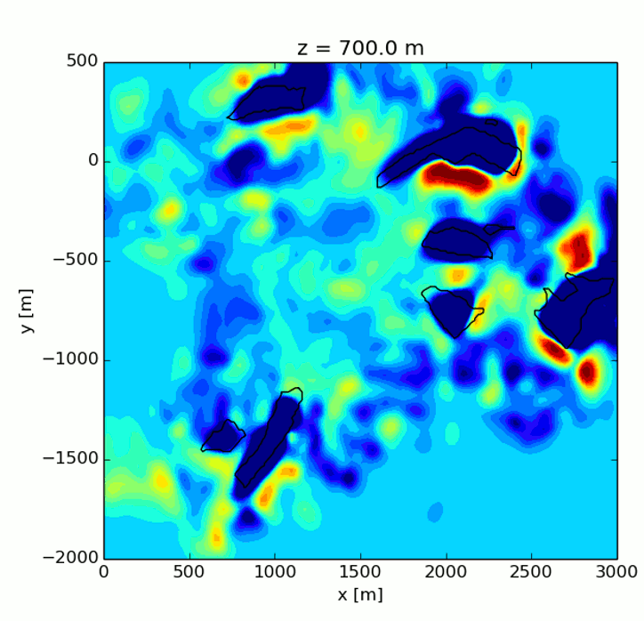
RockSigma BEMIS product
BEMIS is a fully automatic, near real-time, robust and self-learning seismic processing service of mining induced seismic events
GET TO KNOW YOUR ROCK MASS
Notes:
Give a deep understanding of how mining affects the surrounding rock mass.
Provide a fast, reliable, accurate and more precise system for seismic processing, based on state-of-the-art statistical models and machine-learning techniques.
Replace today’s seismic processing with a service that is fully automatic with self-learning capabilities that adapts for the continuously changing mining environment.

Slide 18
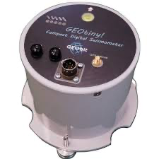
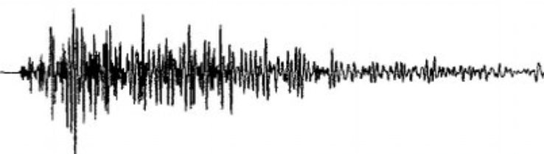
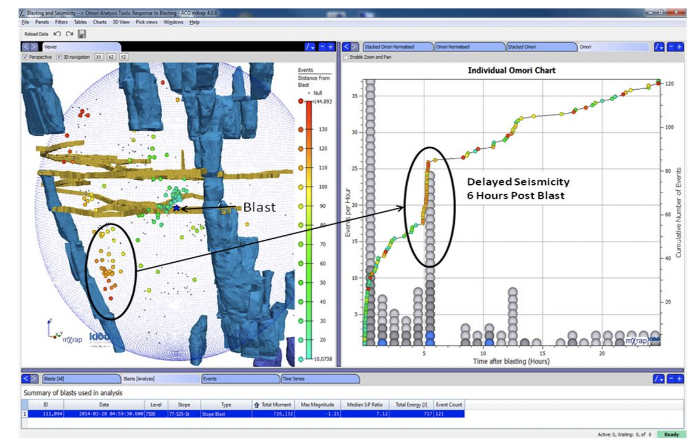
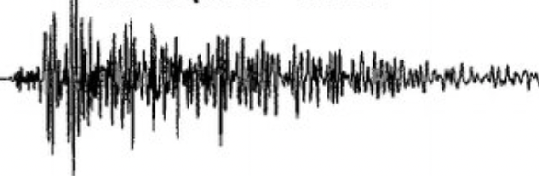
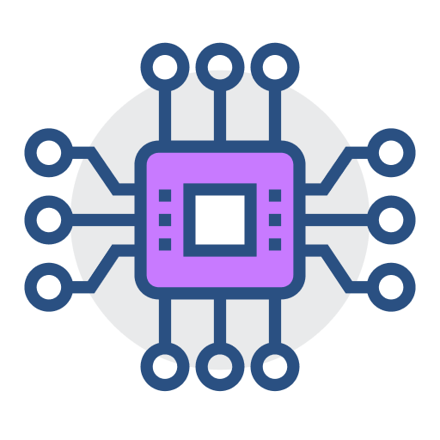
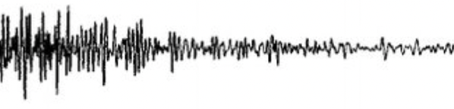
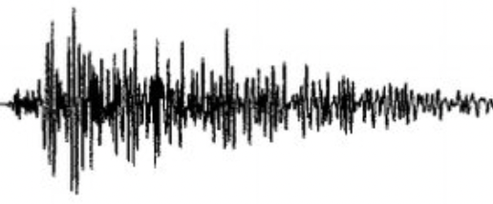
BEMIS
Seismograms
Compute Engine
Visualization
BEMIS
Seismograms
API
API
10⁶ seismograms every day
>100 TB every year
Event Database
Notes:
geologist

Slide 19
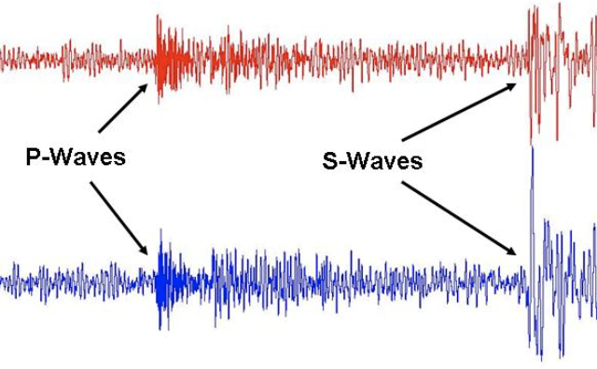

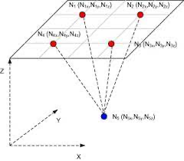
Pick (f₁)
Associate (f₂)
Locate (f₃)
Notes:
shear waves

Slide 20
P1
f₁
f₁ = pick(seismograms)
P2
f₂
f₂ = associate(seismograms)
P4
f₃
P5
f₃
P6
f₃
P7
f₃
f₃ = locate(seismograms)
Pick (f₁)
Associate (f₂)
Locate (f₃)

Slide 21
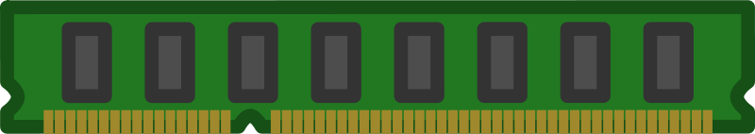
P1
f₁
f₁ = pick(seismograms)
P2
f₂
f₂ = associate(seismograms)
P4
f₃
P5
f₃
P6
f₃
P7
f₃
f₃ = locate(seismograms)
Colonies Runtime API
POD 1
POD N
Event Database
Colonies Worker
Colonies Worker
Colonies Worker
Colonies Worker
P1
f₁
P2
f₂
P5
f₃
…
P7
f₃
P4
f₃
Kubernete Pods
P6
f₃
Seismograms
Kubernetes

Slide 22
How to develop Colonies applications?
Develop different Colonies Workers, implementing all required functions
Like Microservices, different Teams may be responsible for different Workers
Each Worker can be tested seperately
Find a way to construct Workflows/DAGs
Declarative using YAML/JSON
Submit meta-processes/DAGs using a SDK
Use Generators

Slide 23
How to construct DAGs?
e.g. 100 sesimograms added
Picking Generator
Step 1
“Picking meta-processes” are added to graph when X seismograms have been added to database

Slide 24
How to construct DAGs?
e.g. 100 sesimograms added
Picking Generator
Step 1
“Picking meta-processes” are added to graph when X seismograms have been added to database
P1
f₁ (args)

Slide 25
How to construct DAGs?
Picking Generator
Step 1
“Picking meta-processes” are added to graph when X seismograms have been added to database
P1
f₁ (args)
P2
f₁ (args)

Slide 26
How to construct DAGs?
Picking Generator
Step 1
“Picking meta-processes” are added to graph when X seismograms have been added to database
P1
f₁ (args)
P2
f₁ (args)
P3
f₁ (args)

Slide 27
How to construct DAGs?
Picking Generator
Step 1
“Picking meta-processes” are added to graph when X seismograms have been added to database
P1
f₁ (args)
P2
f₁ (args)
P3
f₁ (args)
P1
f₁
P1
f₁
P1
f₁
Colonies Worker

Slide 28
How to construct DAGs?
Step 1
“Picking meta-processes” are added to graph when X seismograms have been added to database
P1
f₁ (args)
P2
f₁ (args)
P3
f₁ (args)
Associate Generator
P1
f₁
P2
f₁
P3
f₁
Colonies Worker

Slide 29
How to construct DAGs?
Step 1
“Picking meta processes” are added to graph when X seismograms have been added to database
P1
f₁ (args)
P2
f₁ (args)
P3
f₁ (args)
Associate Generator
P2
f₂
Step 2
“Associate meta-processes” are added to graph when Y picking processes has finished

Slide 30
How to construct DAGs?
Step 1
“Picking meta processes” are added to graph when X seismograms have been added to database
P1
f₁ (args)
P2
f₁ (args)
P3
f₁ (args)
P2
f₂
Step 2
“Associate meta-processes” are added to graph when Y picking processes has finished
Step 3
“Locate meta-processes” are added to graph by worker when executing the Associate process
P4
f₂
Colonies Worker

Slide 31
How to construct DAGs?
Step 1
“Picking meta processes” are added to graph when X seismograms have been added to database
P1
f₁ (args)
P2
f₁ (args)
P3
f₁ (args)
P2
f₂
Step 2
“Associate meta-processes” are added to graph when Y picking processes has finished
P3
f₃
P4
f₃
P5
f₃
P6
f₃
Step 3
“Locate meta-processes” are added to graph by worker when executing the Associate process
P4
f₂
Colonies Worker

Slide 32
How to construct DAGs?
Step 1
“Picking meta processes” are added to graph when X seismograms have been added to database
P1
f₁ (args)
P2
f₁ (args)
P3
f₁ (args)
P2
f₂
Step 2
“Associate meta-processes” are added to graph when Y picking processes has finished
P3
f₃
P4
f₃
P5
f₃
P6
f₃
Step 3
“Locate meta-processes” are added to graph by worker when executing the Associate process
Step 4
“Locate processes are executed
P3
f₃
P4
f₃
P5
f₃
P6
f₃
Colonies Worker

Slide 33
P
f₁ (args)
P
f₁ (args)
P
f₁ (args)
P
f₁ (args)
P
f₁ (args)
P
f₂
P
f₂
P
f₂
P
f₃
P
f₃
P
f₃
P
f₃
P
f₃
P
f₃
P
f₃
P
f₃
P
f₃
P
f₃
P
f₁ (args)
P
f₁ (args)
P
f₁ (args)
P§§
f₁ (args)
P
§§§§§f₁ (args)
P
f₁ (args)
P
f₁ (args)
P
f₁ (args)
P
f₂
P
f₂
P
f₂
P
f₂
P
f₃
P
f₃
P
f₃
P
f₃
P
f₃
P
f₃
P
f₃
P
f₃
P
f₃

Slide 34
P
f₁ (args)
P
f₁ (args)
P
f₁ (args)
P
f₁ (args)
P
f₁ (args)
P
f₂
P
f₂
P
f₂
P
f₃
P
f₃
P
f₃
P
f₃
P
f₃
P
f₃
P
f₃
P
f₃
P
f₃
P
f₃
P
f₁ (args)
P
f₁ (args)
P
f₁ (args)
P§§
f₁ (args)
P
§§§§§f₁ (args)
P
f₁ (args)
P
f₁ (args)
P
f₁ (args)
P
f₂
P
f₂
P
f₂
P
f₂
P
f₃
P
f₃
P
f₃
P
f₃
P
f₃
P
f₃
P
f₃
P
f₃
P
f₃

Slide 35
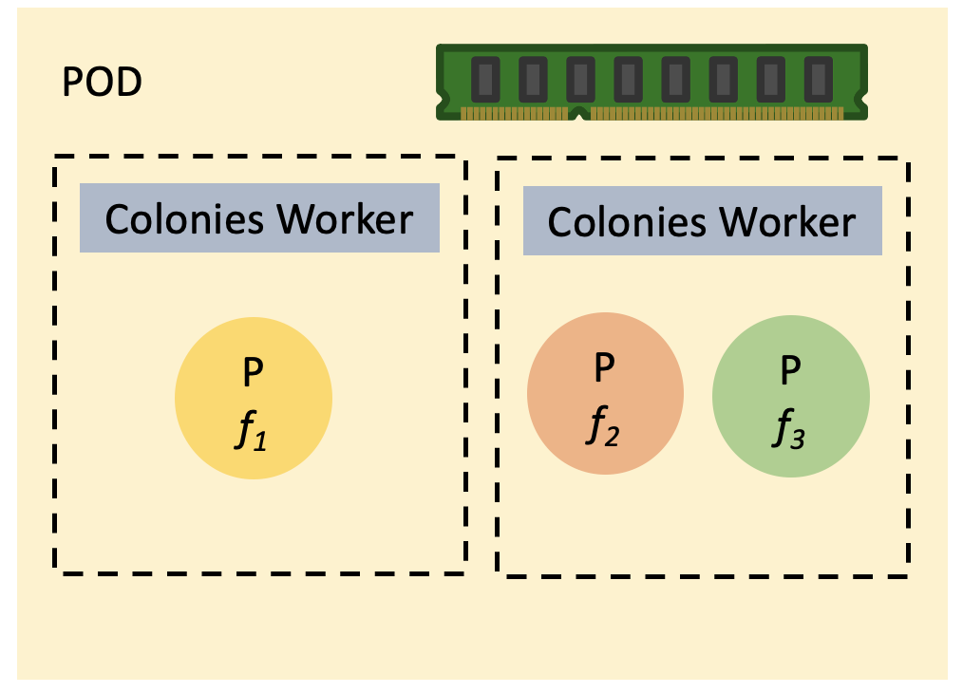
Autoscaling Colonies workers
Add more workers to meet SLA if there too many waiting meta processes
Scale down the system to save cloud costs if worker utilization is low
Colonies
Autoscaler
2 Pods
3 Pods
Scale up
API
Kubernetes

Slide 36
Meta processes timeouts
Waiting
Running
MaxExecTime = 200 s
MaxRetries = 3
State: Waiting
Assigned Worker: None
Retries: 0
Colonies Server
Failed
P1
f₁
Colonies Worker A

Slide 37
Meta processes timeouts
Waiting
Running
MaxExecTime = 200 s
MaxRetries = 3
State: Running
Assigned Worker: Worker A
Retries: 0
Colonies Server
Failed
P1
f₁
Colonies Worker A
P1
f₁

Slide 38
Meta processes timeouts
Waiting
Running
MaxExecTime = 200 s
MaxRetries = 3
State: Running
Assigned Worker: Worker A
Retries: 0
Colonies Server
Failed
P1
f₁
Colonies Worker A
P1
f₁

Slide 39
Meta processes timeouts
Waiting
Running
MaxExecTime = 200 s
MaxRetries = 3
State: Waiting
Assigned Worker: None
Retries: 1
Colonies Server
Failed
P1
f₁
Colonies Worker A

Slide 40
Meta processes timeouts
Waiting
Running
MaxExecTime = 200 s
MaxRetries = 3
State: Running
Assigned Worker: Worker B
Retries: 1
Colonies Server
Failed
P1
f₁
Process state will be failed after 3 retries
Colonies Worker A
Colonies Worker B
P1
f₁

Slide 41
Chaos engineering
We know have a fail-safe mechanism to handle worker failures
So, we are going to randomly kill workers, even in production system
Increased system stability and robustness (and secure)
Scaling up/down becomes easy
Upgrading the system (e.g. deploying new ML model) becomes easy
Programmed Cell Death (Apoptosis) in multicellular organisms
Notes:
The number of cells in this community is tightly regulated—not simply by controlling the rate of cell division, but also by controlling the rate of cell death.

Slide 42





Zero-trust security
Server Owner
Process API
Colony Owner
Identity management via a built-in crypto-protocol (ECDSA)
IDs are SHA-246 hashes of public keys, and public keys can be derived from signatures
All RPC messages to the Colonies server must be signed with a private key
Colonies Server
Colony
Colony API
Runtime API
ID Worker A
Server Key
ID Worker B
Colony Key
Process API
Internet
Colonies Worker A
Colonies Worker B
Runtime Key A
Runtime Key B
Notes:
Concept that has been around for more than a decade, which is based on the though of “never trust, always verify”. The reasons that concept has gotten hot in last couple of years is because as organizations move to hybrid cloud and they started to lose control where data is stored.
Make sure only the right user have only right access to only the right data for the right purpose.
Only the right user can come in can come in.
Only access the right data.
Only the right reason.
Adaptive authentication, risk score. Worker is connected from a jailbrake deviced from new place on the other side on the planet.c

Slide 43
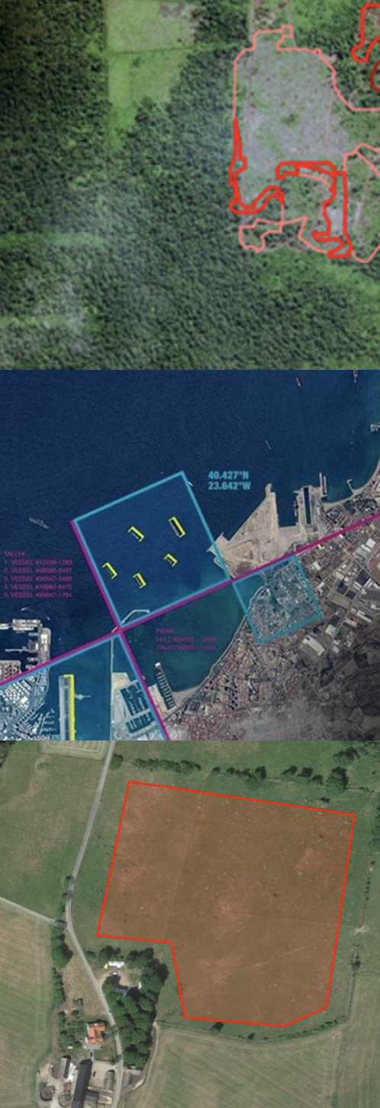
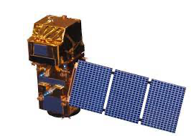
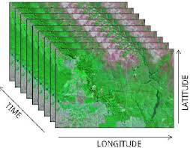
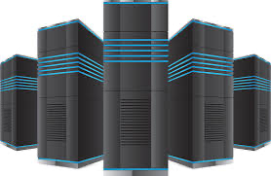
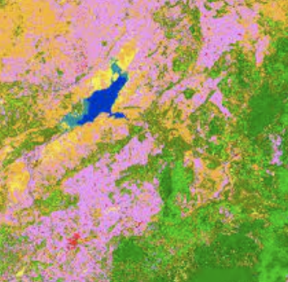
Earth observation
Sentinell-2
Satellite images
HPC Supercomputer
Forest monitoring
Grassland monitoring
Change detection

Slide 44
P1
f₁
P2
f₂
f₁ = deploy_a_hpc_cluster() : hpc
f₂ = select_staellite_products(area_of_interest, dates) : products
f₃ = download_satellite_products(products) : dataset
f₄ = filter_and_create_netcdf_dataset(dataset) : netcdf_dataset
f₅ = transfer_netcdf_dataset_to_hpc_cluster(netcdf_dataset)
f₆ = run_neural_network(hpc, netcdf_dataset) : result
f₇ = save(result)
f₈ = notify_user(result)
f₉ = destroy_hpc_cluster(hpc)
P3
f₃
P4
f₃
P5
f₃
P6
f₃
P7
f₄
P8
f₅
P9
f₆
P10
f₇
P11
f₈
P12
f₉

Slide 45
More information
https://colonyos.io
https://github.com/colonyos/colonies
SDKs
Golang
Rust
Julia
Python
JavaScript
and Haskell

